Slide 1
Lesson 21 – Homework review

Slide 2
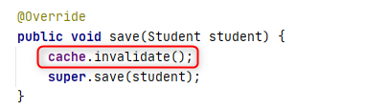
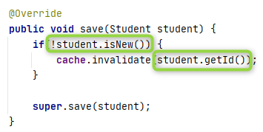
Invalidate only obsolete

Slide 3
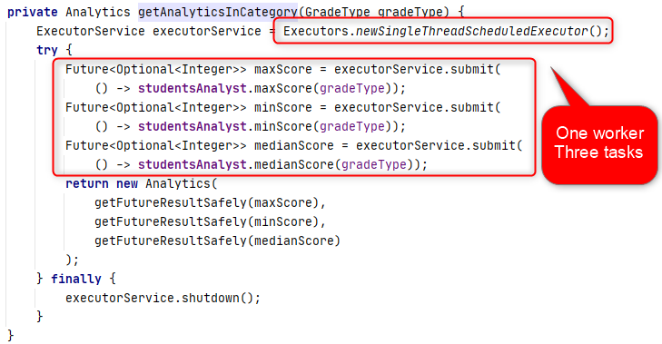
Optimization?
ExecutorService executorService = Executors.newFixedThreadPool(3);

Slide 4
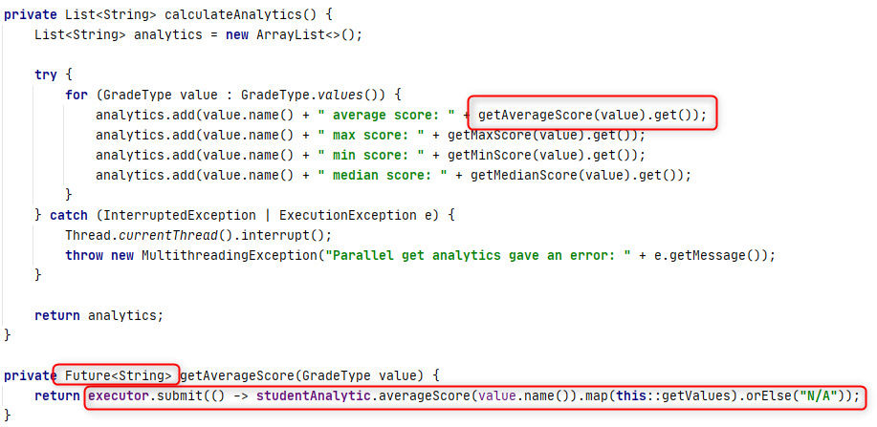
Optimization?
Start all calculations and only then collect results

Slide 5
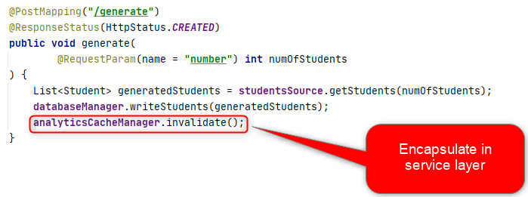
Hide details

Slide 6
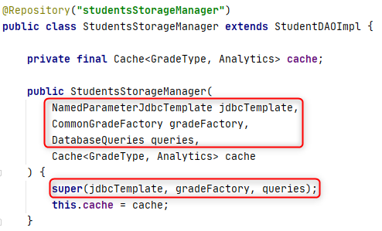
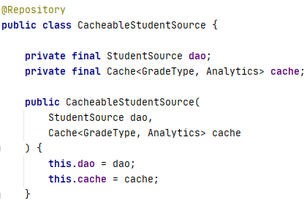
Composition vs Inheritance

Slide 7
Thanks!
Any Questions?
Or find us in Slack:
@Yaroslav Brahinets
@Vasya Rudas

